Slide 1
Important concepts
Do Quoc Binh

Slide 2
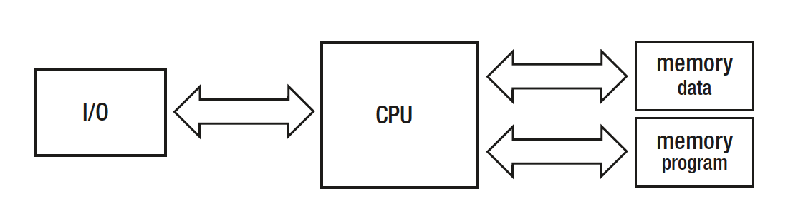
Harvard architecture diagram
It is used today in almost every computer as the modified Harvard architecture.

Slide 3
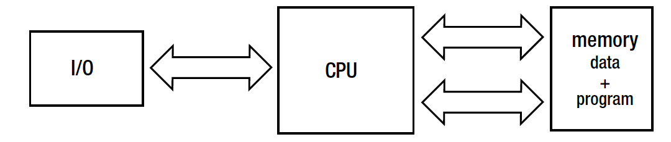
Von Neumann architecture diagram
It is a simplified Harvard architecture in which there is a single memory unit for storing both the data and the program.
From a high-level point of view, this is exactly how modern computers are still being constructed

Slide 4
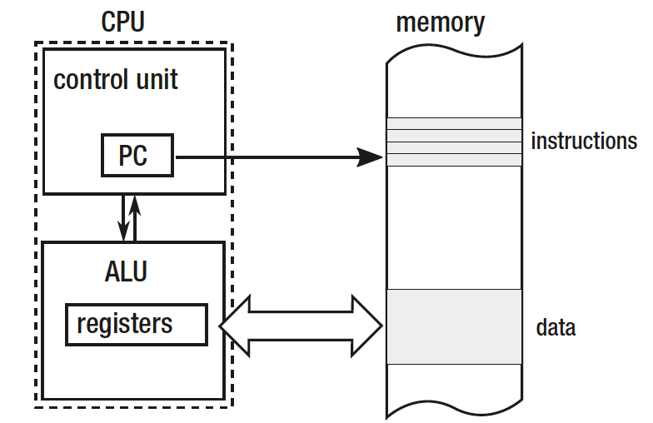
Stored-program computers
Von Neumann architecture leads as to the term of stored-program computers that is obvious nowadays

Slide 5
The Static Allocation
Nowadays we still use static allocation in such a sense when creating static global variables and the like, stored in a special data segment of a program.

Slide 6
The Register Machine
Machines that use registers (or accumulators as a special case) to operate on Arithmetic Logic Units (ALUs)
This is because most modern computers are kind of complex register machines.
If we want to add, divide, or do anything else, we must load proper data from memory into proper registers then we call specific instructions to invoke proper operations on them and then another one to store the result from one of the registers into memory.

Slide 7
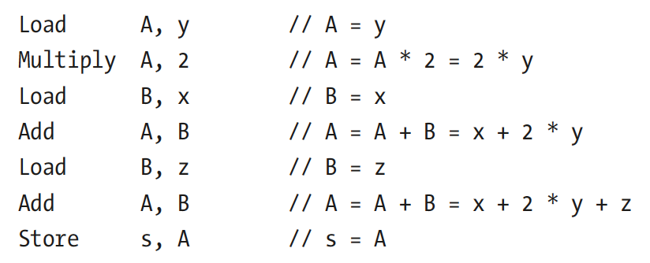
Example: Calculation on two-register register machine s=x+(2*y)+z

Slide 8
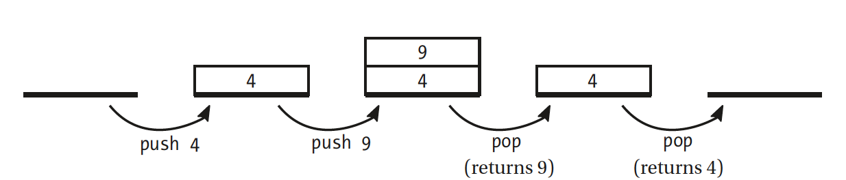
The Stack
Conceptually, the stack is a data structure that can be simply described as “last in, first out” (LIFO) list
Today’s .NET heavily uses a “call stack” and “stack” concepts

Slide 9
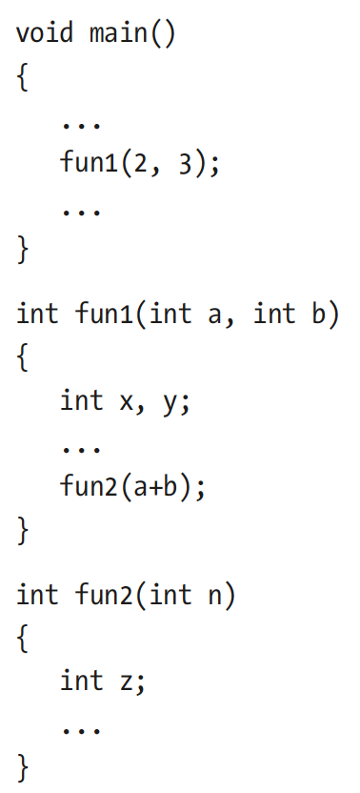
Example use of stack(a C program)

Slide 10
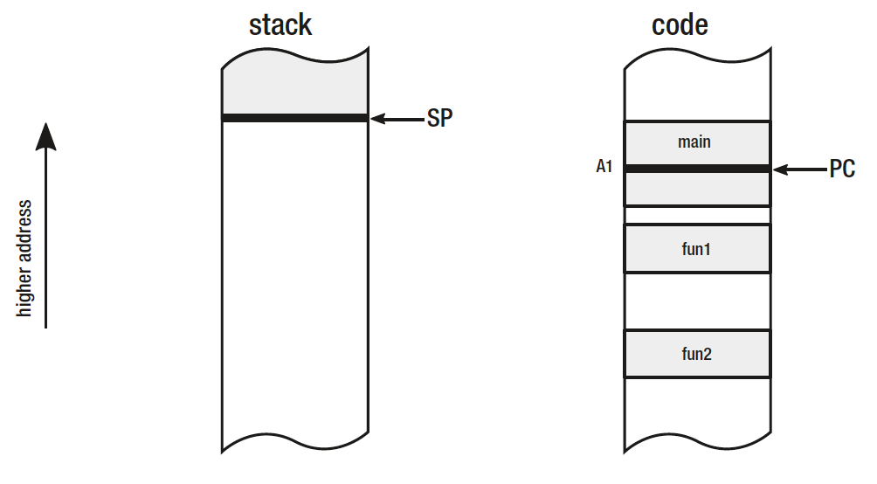
Stack and code memory regions - at the moment before calling function fun1
Stack pointer (SP) keeps an address indicating the current boundary of the Stack
Program counter (PC) points somewhere inside the main function (we marked this as address A1)

Slide 11
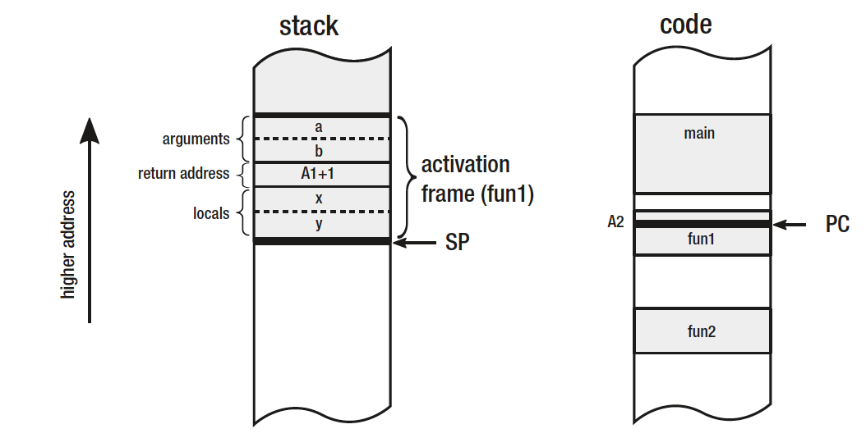
Stack and code memory regions - at the moment after calling function fun1
Arguments - all function arguments can be saved on stack
A1+1 address (pointing to the next instruction after instruction under A1 address)
Local variables - a place for all local variables
Such a structure placed on stack when a subroutine is being called is named an activation frame.

Slide 12
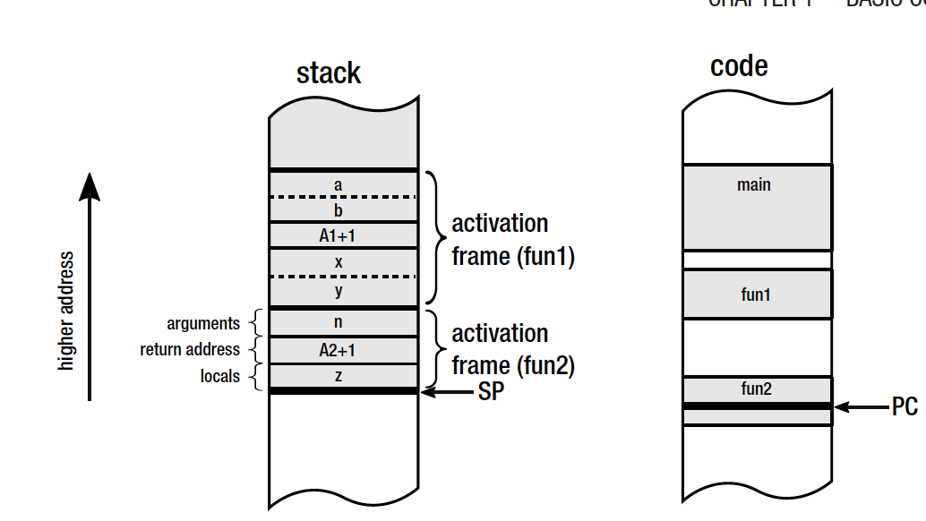
Stack and code memory regions - at the moment after calling function fun2 from fun1

Slide 13
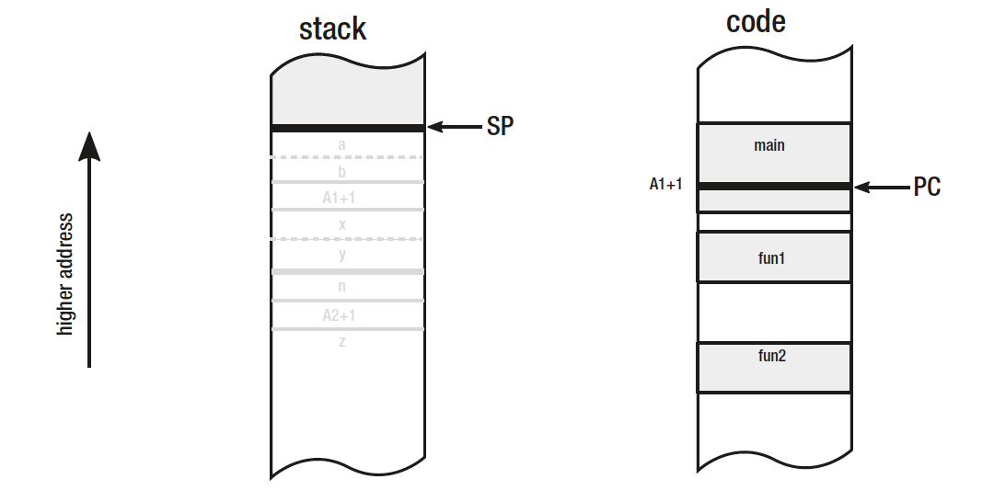
Stack and code memory regions - after returning from function fun1 both activation frames are discarded

Slide 14
The Stack Machine
In contrast to the registry machine, in the stack machine all instructions are operating on the dedicated, expression stack (or evaluation stack)
Hence, such a machine could have both an additional “expression stack” and a general-purpose stack
By default, instructions are taking arguments from the top of the expression stack - as many as they require
The result is also stored on the top of the stack

Slide 15
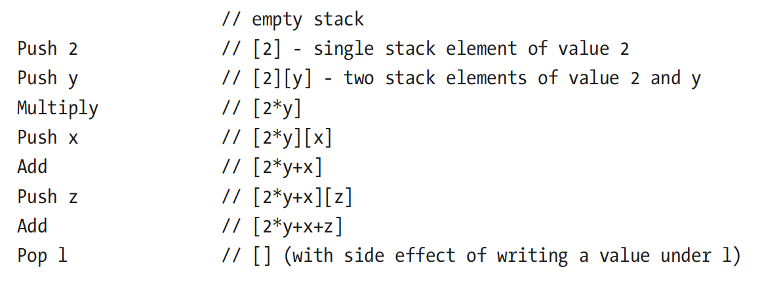
Stack machine realizing s=x+(2*y)+z calculation

Slide 16
Main advantages of stack machines
There is no problem regarding how and where to store temporary values - whether they should be registers, stack, or main memory. Thus, it simplifies implementation.
Allowing efficient binary encoding of the instructions and hence produces dense binary code.
It is a great way of designing platform-independent virtual machines or execution engines.
Sun’s Java Virtual Machine and .NET runtime are perfect examples of stack machines.

Slide 17
The Pointer
Harold Lawson, involved in PL/I language development, was awarded by IEEE in 2000 “for inventing the pointer variable and introducing this concept into PL/I, thus providing for the first time, the capability to flexibly treat linked lists in a general-purpose high level language.”
To perform list processing and operate on other more or less complex data structures.
The pointer concept was then used during the development of the C language

Slide 18
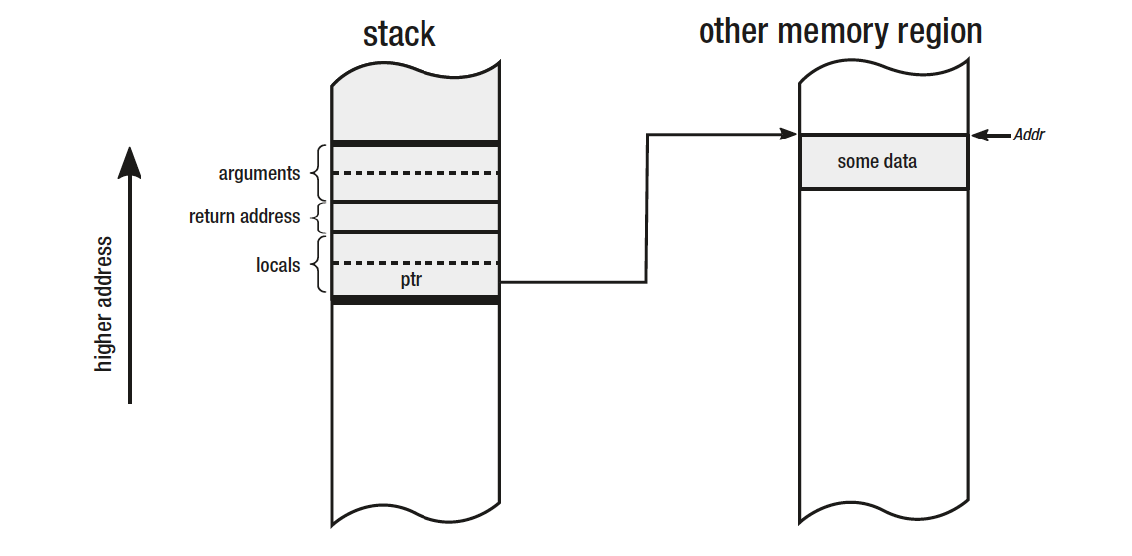
The Pointer(2)
Pointers are variables in which we store the address of the position in memory.

Slide 19
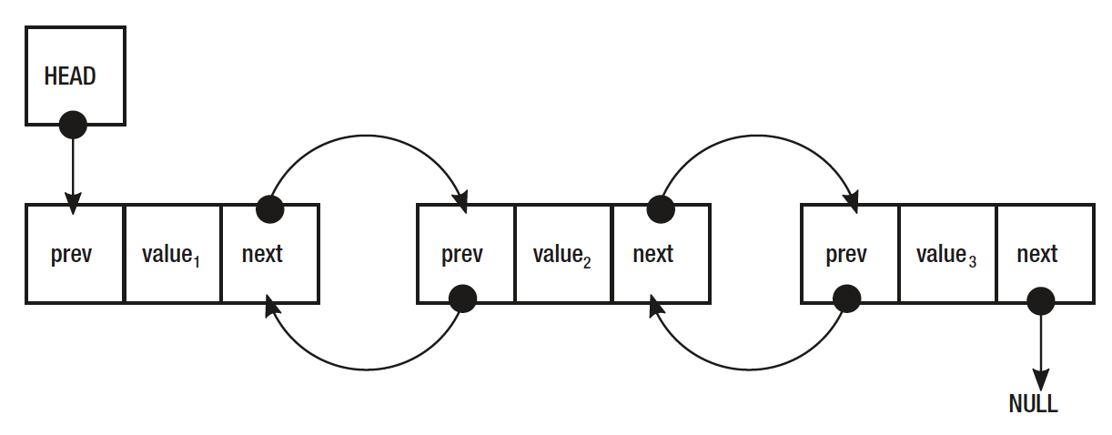
The pointer[3]
The simple idea of pointers allows us to build sophisticated data structures like linked lists or trees because data structures in memory can reference each other, creating more complex structures

Slide 20
Pointer in C

Slide 21
Unsafe code and pointers
To maintain type safety and security, C# does not support pointer arithmetic, by default.
However, by using the unsafe keyword, you can define an unsafe context in which pointers can be used

Slide 22
Unsafe code has the following properties
Methods, types, and code blocks can be defined as unsafe
In some cases, unsafe code may increase an application's performance by removing array bounds checks
Using unsafe code introduces security and stability risks
The code that contains unsafe blocks must be compiled with the -unsafe compiler option

Slide 23
Pointers in high level language
Pointers in high-level languages like Java or C# are often not available or must be explicitly enabled, and it makes such code unsafe.
To run ansafe code in C# the program must be compiled with the -unsafe compiler option set
You can call the native functions. Fore more https://docs.microsoft.com/en-us/cpp/dotnet/calling-native-functions-from-managed-code?view=vs-2019

Slide 24
The Heap
The heap (less known also as the Free Store) is an area of memory used for dynamically allocated objects.
In fact, one might rightly ask what is the relationship between the heap data structure and the heap itself. The truth is - there is none.
The heap is just more like a “black box” that can be asked for providing memory, no matter where it will come from.

Slide 25
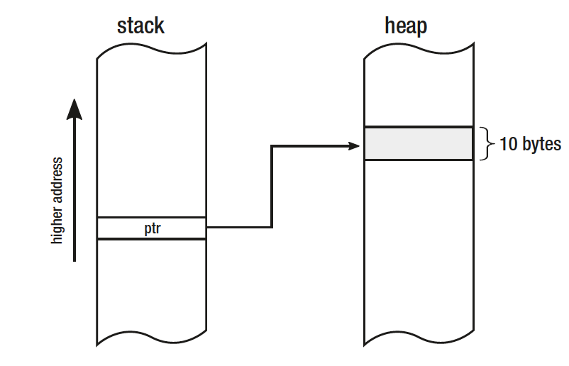
Stack with pointer ptr and 10-bytes wide block on the heap
PTR ptr = allocate(10);

Slide 26
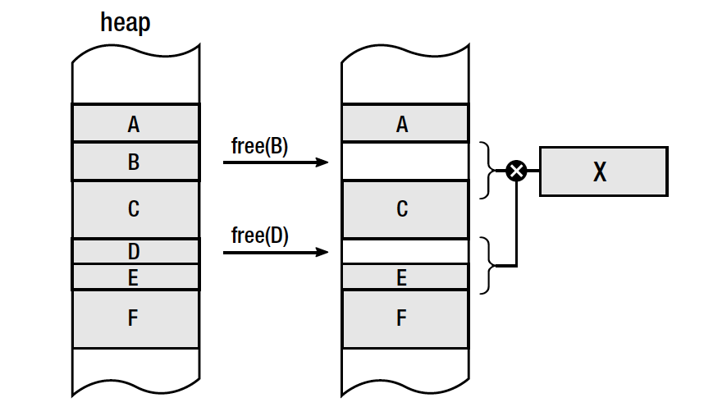
Heap fragmentation
There is no enough
space for new object X although in total there is enough free space for it

Slide 27
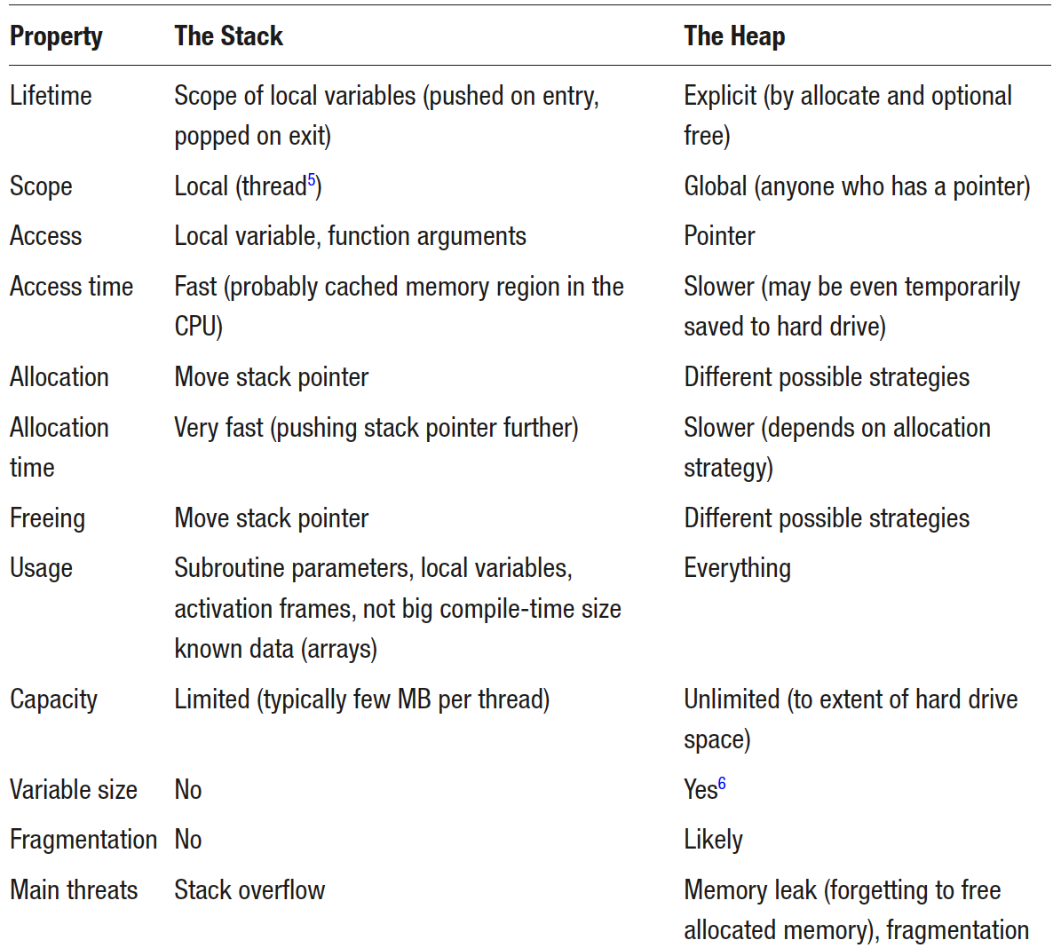
Comparison of the Stack and the Heap Features

Slide 28
Virtual Memory
In particular it means that each process thinks it is the only one running in the system and that the whole memory is for its own purposes. Even more.
Because address space is virtual, it can be larger than the physical memory.
This allows it to extend physical DRAM memory with secondary storage like mass storage hard drives.
The address space for each process is private and cannot be accessed by other processes unless it is shared

Slide 29
OS and Virtual memory
Mapping virtual address space to physical memory - there is 32-bit-long virtual address on 32-bit machines and 64-bit long on 64-bit machines
Moving some memory regions from DRAM memory to hard drives and back as they are requested or currently not needed. Obviously as the total used memory may be bigger than physical memory, sometimes some parts of it must be temporarily stored to slower media like HDD. A place where such data is stored is called page file or swap file.

Slide 30
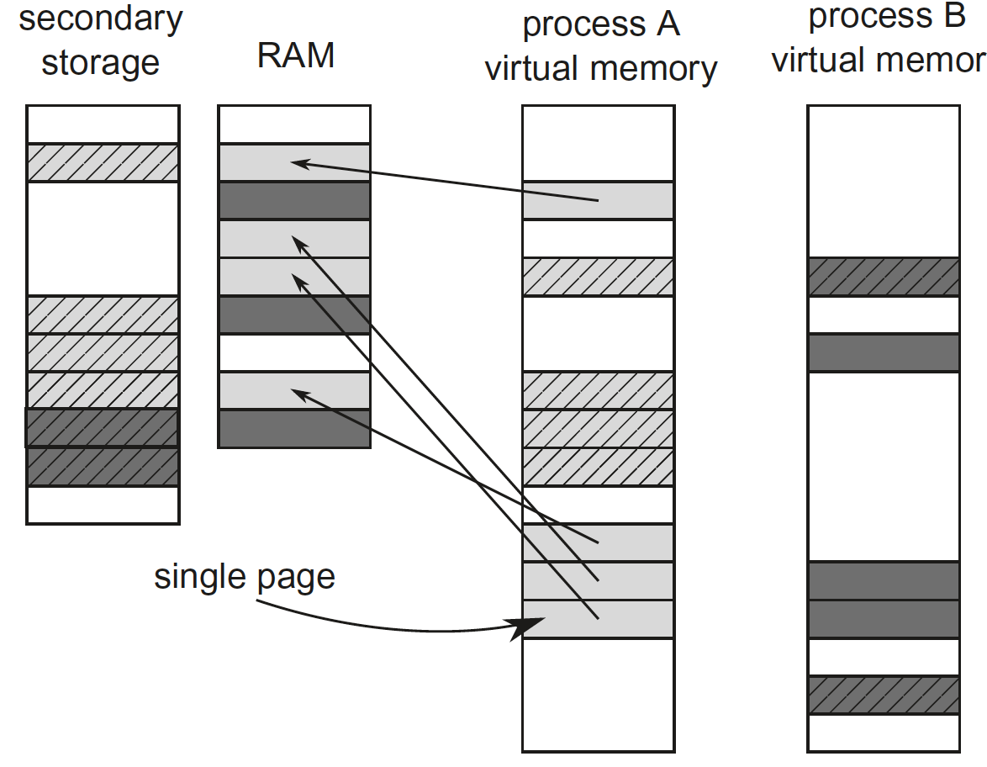
Virtual to physical pages mapping
Each process (A is light gray and B is dark gray) sees its own virtual address space but physically their pages are stored both in RAM (solid-filled pages) and paged (swapped) to disk (dash-filled pages)

Slide 31
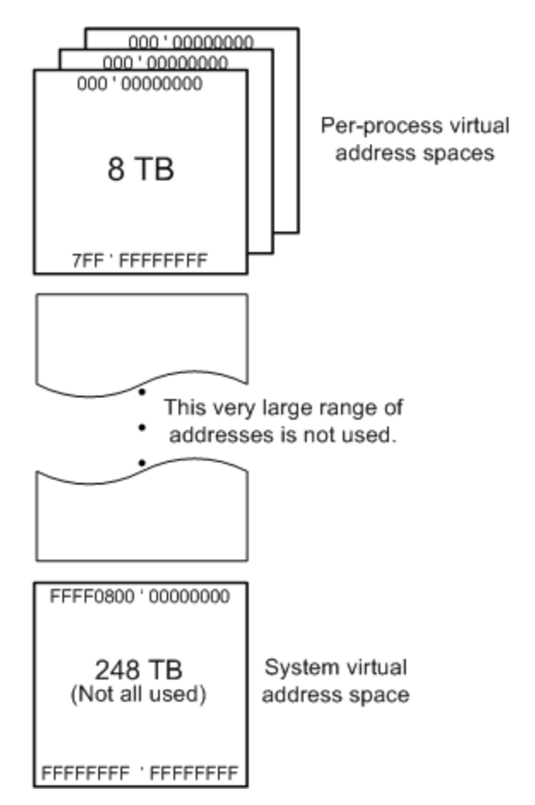
In 64-bit Windows
1EB = 1Million TB
In 64-bit Windows, the theoretical amount of virtual address space is 2^64 bytes (16 exabytes)
The 8-terabyte range from 0x000'00000000 through 0x7FF'FFFFFFFF is used for user space
248-terabyte range from 0xFFFF0800'00000000 through 0xFFFFFFFF'FFFFFFFF are used for system space

Slide 32
Recursive methods
Recursive methods are either
Tail recursive
Nontail recursive
Tail recursive method has the recursive call as the last statement in the method.
Recursive methods that are not tail recursive are called non-tail recursive

Slide 33
Garbage Collection
. NET's garbage collector manages the allocation and release of memory for your application
Each time you create a new object, the common language runtime allocates memory for the object from the managed heap
The garbage collector's optimizing engine determines the best time to perform a collection, based upon the allocations being made

Slide 34
Conditions for a garbage collection
The system has low physical memory. This is detected by either the low memory notification from the OS or low memory as indicated by the host
The memory that is used by allocated objects on the managed heap surpasses an acceptable threshold. This threshold is continuously adjusted as the process runs
The GC.Collect method is called. In almost all cases, you do not have to call this method, because the garbage collector runs continuously. This method is primarily used for unique situations and testing

Slide 35
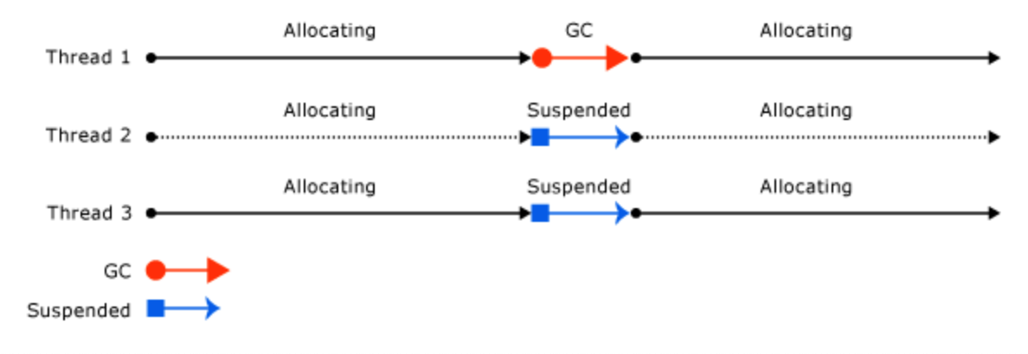
A thread that triggers a garbage collection
Before a garbage collection starts, all managed threads are suspended except for the thread that triggered the garbage collection
The following illustration shows a thread that triggers a garbage collection and causes the other threads to be suspended

Slide 36
More about Garbage collector
https://docs.microsoft.com/en-us/dotnet/standard/garbage-collection/fundamentals

Slide 37
Recursive method
A method that calls itself is known as a recursive method. And, this technique is known as recursion.
When a recursive call is made, new storage location for variables are allocated on the stack
As, each recursive call returns, the old variables and parameters are removed from the stack. Hence, recursion generally use more memory and are generally slow.
On the other hand, recursive solution is much simpler and takes less time to write, debug and maintain.

Slide 38
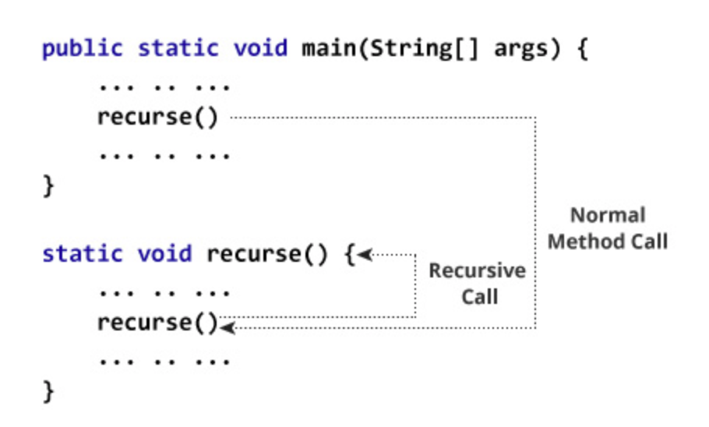
How recursion works?

Slide 39
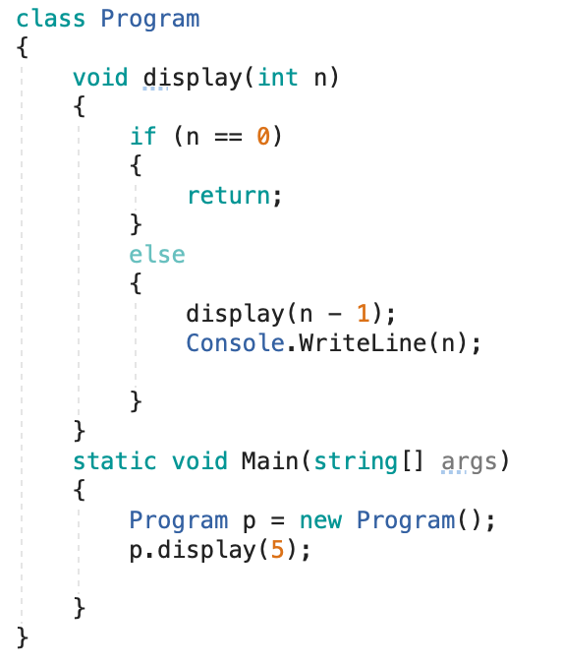
Nontail recursive method
recursion chews up a valuable and limited resource – the stack – and can lead to an unrecoverable type of CLR error: the dreaded StackOverflow
Output:
1
2
3
4
5

Slide 40
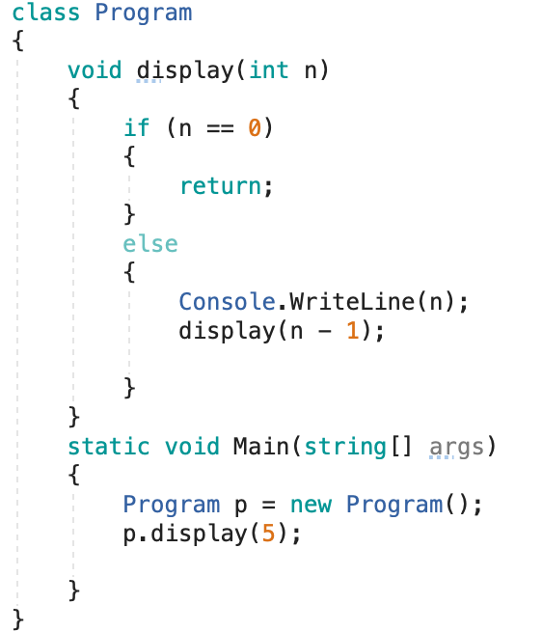
Tail recursive
Output:
5
4
3
2
1
Tail Recursion however is a form of recursion that doesn’t use any stack space, and thus is a way to use recursion safely.

Slide 41
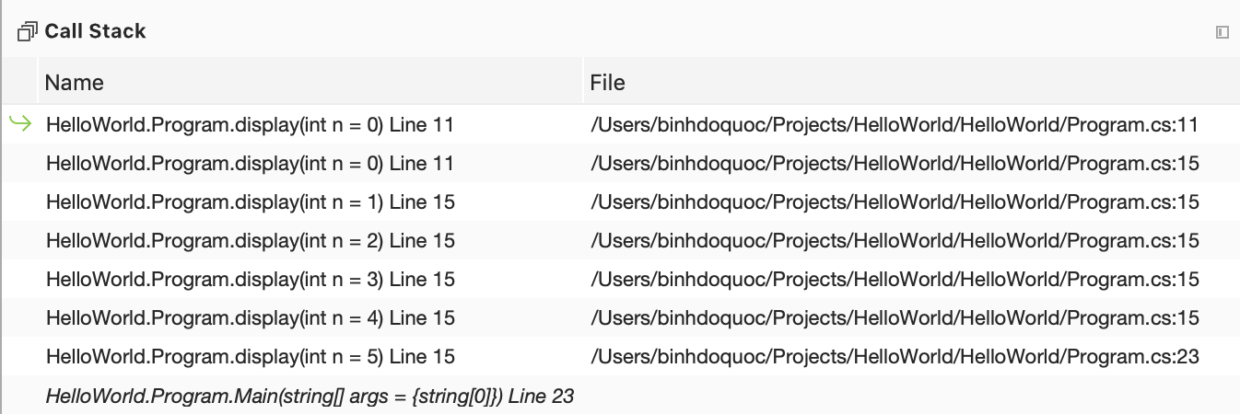
View stack frames in Visual Studio in Debug mode
Notice that each recursive call creates a new stack frame.

Slide 42
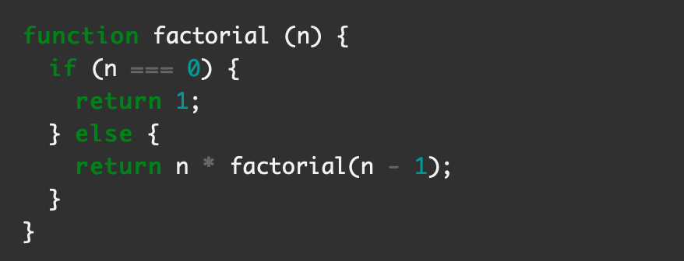
Is it a tail recursion?

Slide 43
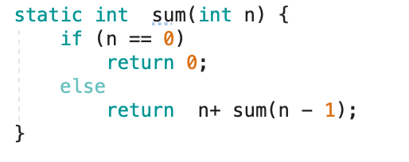
Convert this into a tail recursion

Slide 44
More readings about recursive method
https://blogs.msdn.microsoft.com/chrsmith/2008/08/07/understanding-tail-recursion/
https://www.youtube.com/watch?v=HIt_GPuD7wk

Slide 45
References
Pro .NET Memory Management For Better Code, Performance, and Scalability -Konrad Kokosa- 2018

